Slide 1
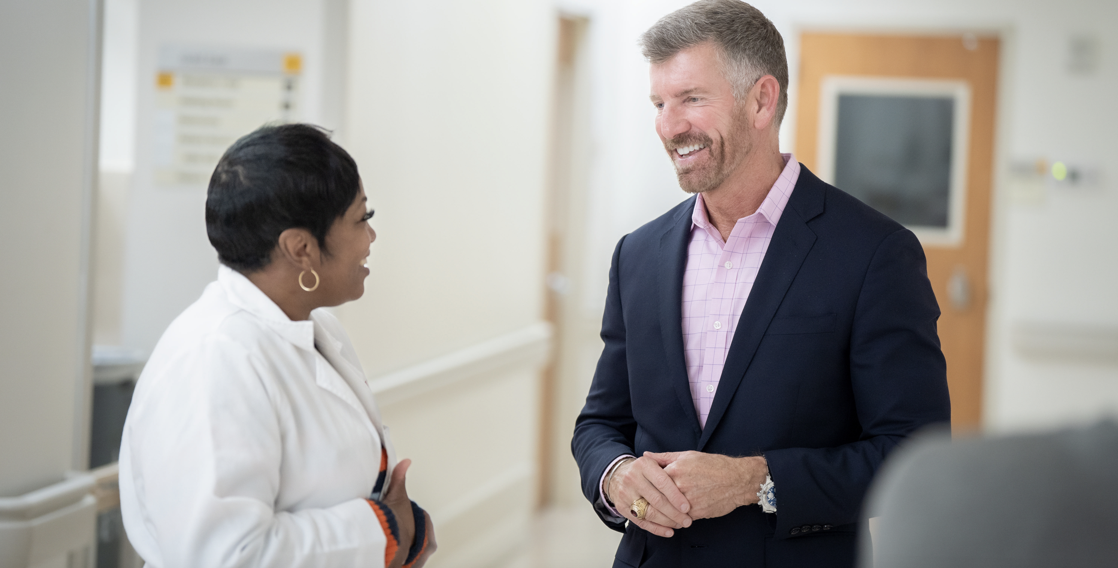
Empowering Our Workforce to Create the Meaningful Work Environments They Seek
Becker’s Healthcare 14th annual Meeting

Slide 2
01
A Recovering and Evolving Workforce
02
Looking at Work though a New Lens
Keck Medicine of USC: A Case Study on Creating a Culture of Purpose
Presentation
Agenda
03
Building Strength at the Middle: “Leaders Co-Learning with Leaders”
04
05
Our Transformation Leadership Model
06
Demonstrating Value
07
Lessons Learned

Slide 3
A Recovering and Evolving Workforce

Slide 4
For the second consecutive year. . .

Slide 5
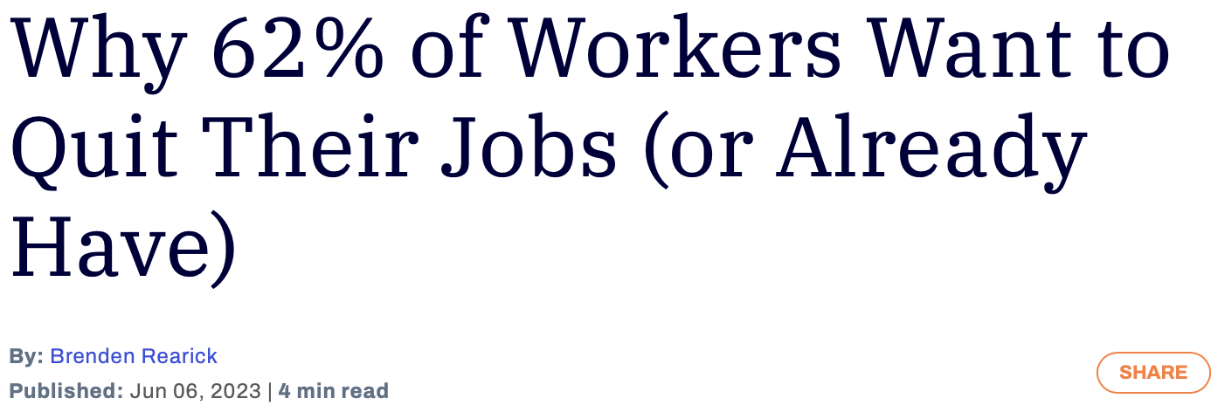
Poor work-life balance
Unfair pay
Toxic workplace culture
Feeling undervalued
Limited advancement
Too much stress
Lack of remote work options
Bad boss
Misaligned values
Inflexible hours

Slide 6
The average hospital lost $7.1 million in 2021 to higher turnover rates
The average hospital loses $5.2 to $9 million on RN turnover yearly
The average turnover cost for a staff RN is $46,100, up more than 15 percent from the 2020 average
For every 20 travel RNs eliminated, a hospital can save $4.2 million on average
In the past 5 years, the average hospital turned over 100.5 % of its workforce

Slide 7
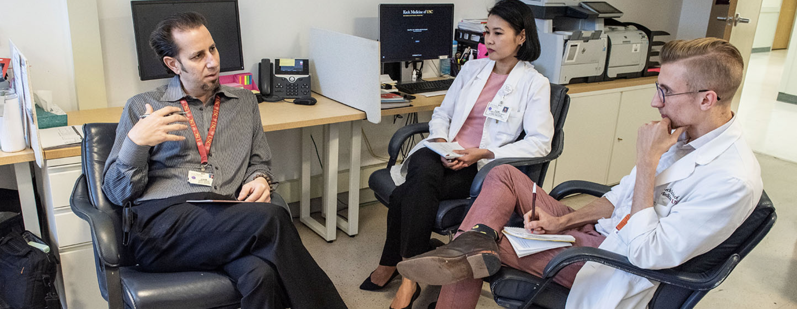
Are we truly addressing the specific needs of our caregivers? Are we prioritizing self and team accountability?

Slide 8
Looking at Work through a New Lens

Slide 9
The Search for Meaning in the Workplace
“Unfortunately, despite its clear value and importance, only 50% of employees find meaning in their work today, per McKinsey.”

Slide 10
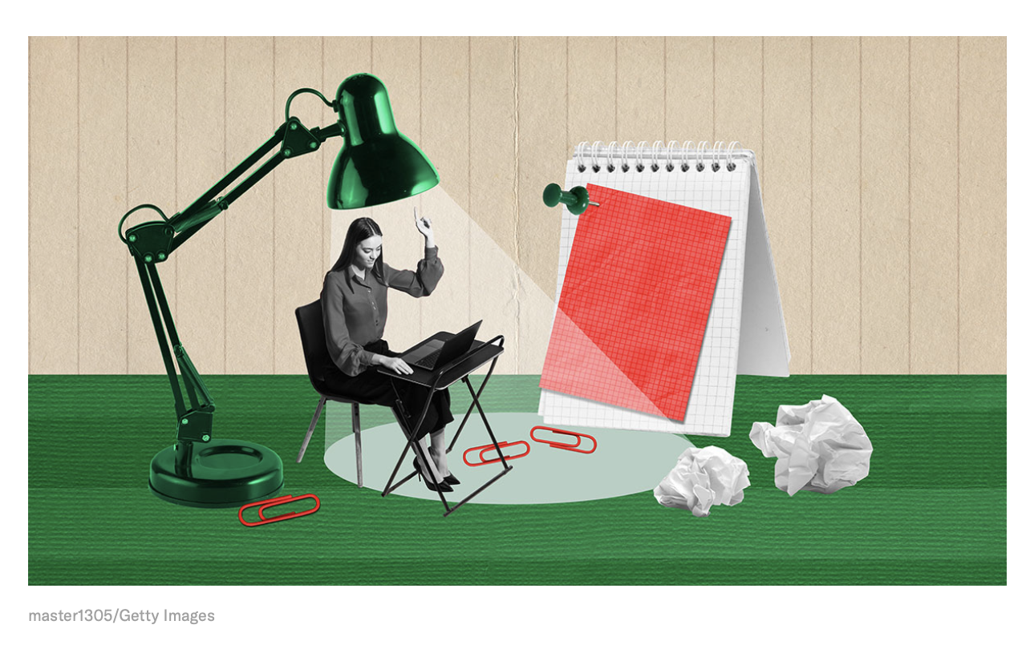
“In fact, research shows that meaningfulness is more important to us than any other aspect of our jobs — including pay and rewards, opportunities for promotion, and working conditions. When we experience our work as meaningful, we’re more engaged, committed, and satisfied. When we don’t, we’re more willing to quit, and this is especially true for younger workers.”

Slide 11
Work is meaningful when we:
Feel we’re contributing to something that matters
Are given challenging opportunities to grow and improve our skills
Experience belonging as part of a community

Slide 12
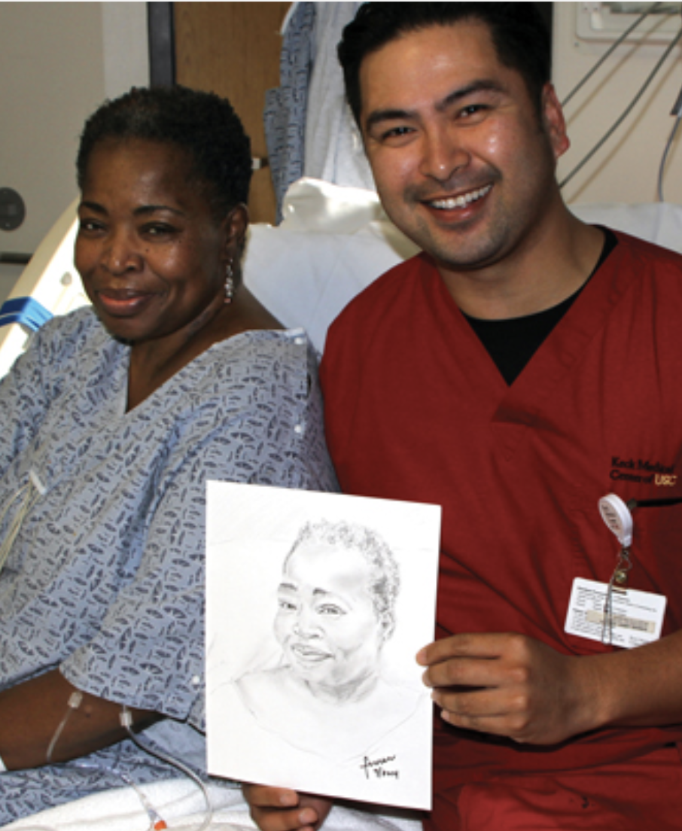
What can we, as healthcare leaders, do to ensure this optimism holds and meaningful work opportunities are more readily available?
Good News: Optimism is Returning
3 in 5 healthcare workers said they are optimistic about the future of the industry
3 in 5 said they have mostly been able to handle the stressors of work experienced in the last six months
Source: American Hospital Association, 2024 Health Care Workforce Scan

Slide 13
Keck Medicine of USC: Creating a Culture of Purpose

Slide 14
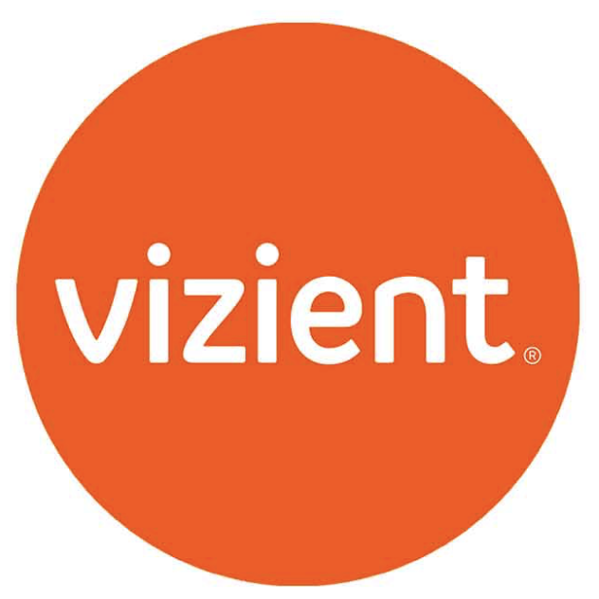
A Young Health System Focusing on Culture to Achieve Quality and Safety Goals and Build a Resilient Workforce
Keck Medicine of USC
formed
2009
2017
2018
2019-2020
Keck Operating System
Awarded Nurse Magnet Status
US News & World Report Best Hospitals Honor Roll ranking
2020
Care for the Caregiver program named Institutional Program of the Year by the Los Angeles Business Journal
Highest case mix index in the country among academic health systems
Leapfrog scores at the bottom of the C category
Quality scores in the bottom quartile of Vizient rankings
Awarded Vizient Rising Star Award for performance on Quality and Accountability Scorecard
2022
2022
2021
Named Vizient Top Performer
Received 7th consecutive Leapfrog “A”
Keck Medicine of USC
2024
2023
2023
Achieved CMS 5-star rating
Received Magnet reaccreditation
©2024 Keck Medicine of USC

Slide 15
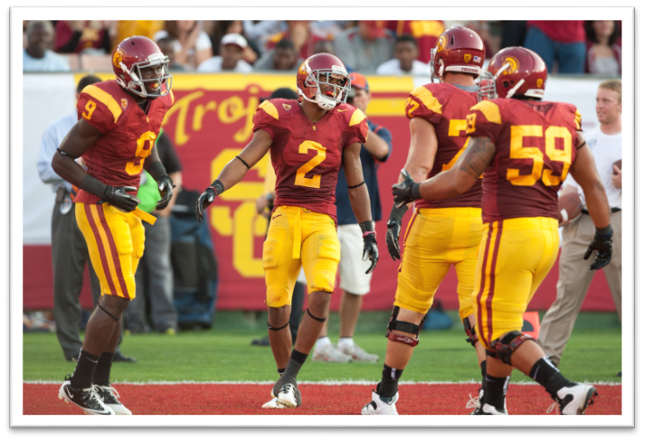
Keck Medicine of USC Leadership Ethos: Rod’s Playbook
POSITIVE/HIGH ENERGY
TEAMWORK
HIGH TRUST
©2024 Keck Medicine of USC
Notes:
Rod to update slide

Slide 16
Professionalism Program: Keck Medicine
Keck Medicine has a robust physician professionalism program and created the first nurse professionalism program in the country.
Accountability/ Goal Setting
Peer “Cup of Coffee” Opportunity
If patterns of concern continue, accountability is discussed, goals are set and guided support is provided by their supervisor.
Physicians and nurses trained by Vanderbilt Center for Patient and Professionalism Advocacy share observations.
Monitoring by Physicians and Nurses
Co-workers share concerns about behavior that may be inconsistent with Keck Commitment through the Daily Incident Reporting System.
Keck Medicine of USC has 100+ physicians and 150+ nurses trained to listen and determine if intervention is needed.
©2024 Keck Medicine of USC

Slide 17
CORS Progress Report
National CORS
Keck Medicine of USC CORS
National CORS
USC Keck CORS
87%
90%
Interventions on 1230 professionals with high coworker indexes
Interventions on
71 professionals with high coworker indexes from 2017-2024
5%
10%
5%
3%
Improved
Unimproved / Worse
Departed Unimproved
©2024 Keck Medicine of USC
Martinez, et al. The Joint Commission Journal on Quality and Patient Safety, 2018 | Webb, et al., The Joint Commission Journal on Quality and Patient Safety, 2016

Slide 18
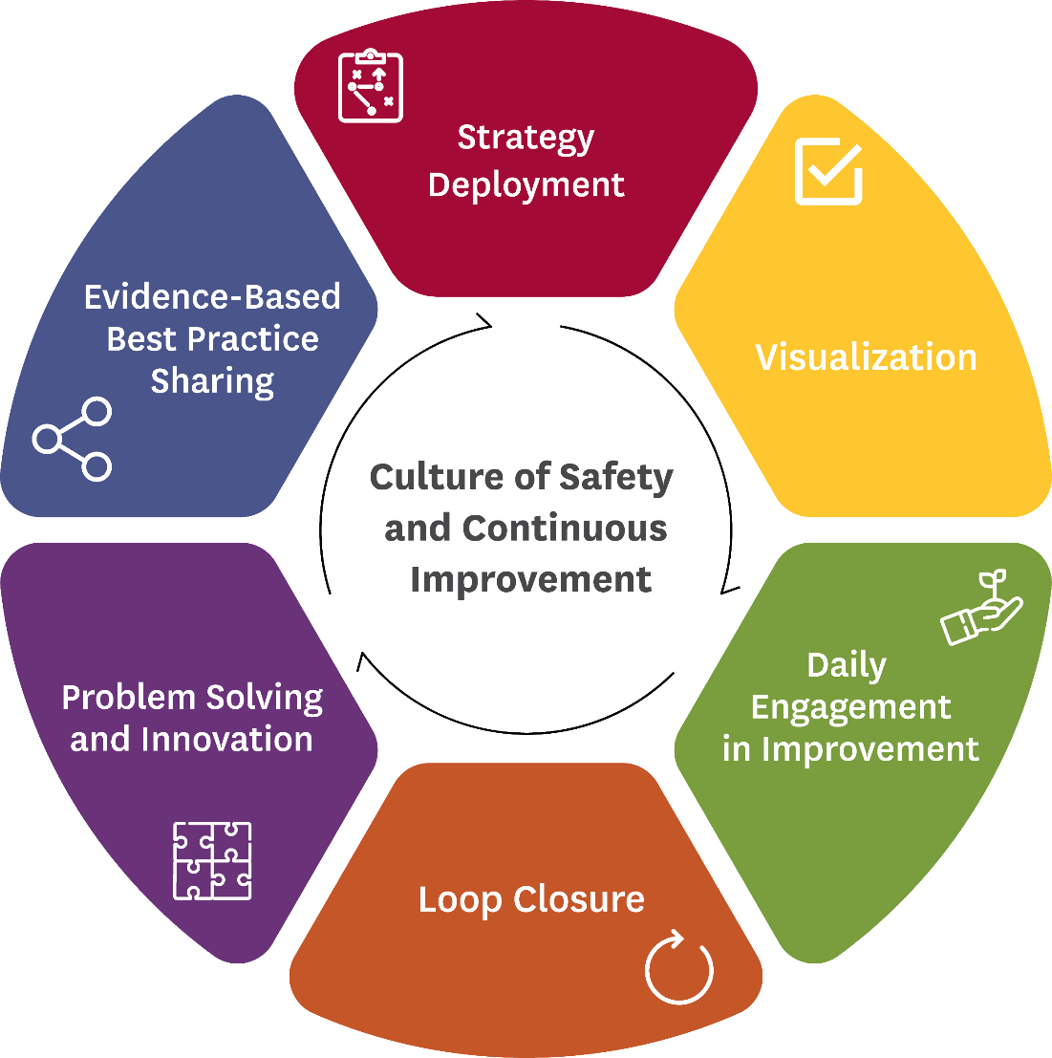
Keck Operating System
Example: Tiered Huddles
8 – 10 am No Meeting Zone
Tier 4
Health System Leadership, across all entities and system functions
At 9:45 AM
Tier 3
Entity C-Suite team with Executive Administrators/ Directors
At 9:15 AM
Tier 2
Directors / Executive Administrators with Managers
By 9 AM
Tier 1
Managers with Frontline Staff / Leads
Before 8:30 AM
©2024 Keck Medicine of USC
Notes:
Moral disengagement – when people raise voices and can’t be heard, they disengage. Burned out workers and unsafe situations have negative outcomes for the health system. Keck Operating System was created so that timely matters can go up to the leaders.

Slide 19
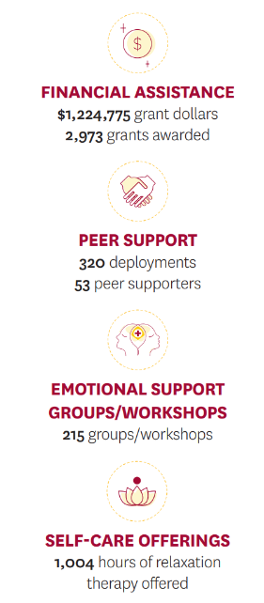
Care for the Caregiver Delivers and Innovates
Founding Principles
New Programs
Ensuring the well-being of our caregivers reduces burnout, lowers turnover and improves patient safety
Wellness support must be comprehensive – physical, mental, emotional, financial – and flexible as needs change
Expanded cumulative stress debriefs and peer support program
Started C.A.R.E. Program, which funds internal teams that propose programming to address burnout, such as team bonding, physical activity and self-care
Launched hybrid Schwartz Rounds
©2024 Keck Medicine of USC

Slide 20
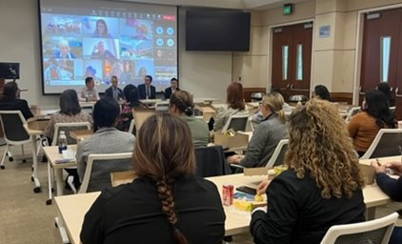
Structured forum for interprofessional conversations about social and emotional experiences of caregiving
Open to all via in-person and virtual sessions held 4-12 times per year organization-wide or unit-based
Case- or topic-specific multidisciplinary panel
I am an RN. And despite being in a room with physicians and other members in much higher organization levels than me, I feel as though my voice/opinions are equally valued. I appreciate the team and all attendants for making such a safe and equal space.
Trauma-informed facilitation to support participant well-being
©2024 Keck Medicine of USC

Slide 21
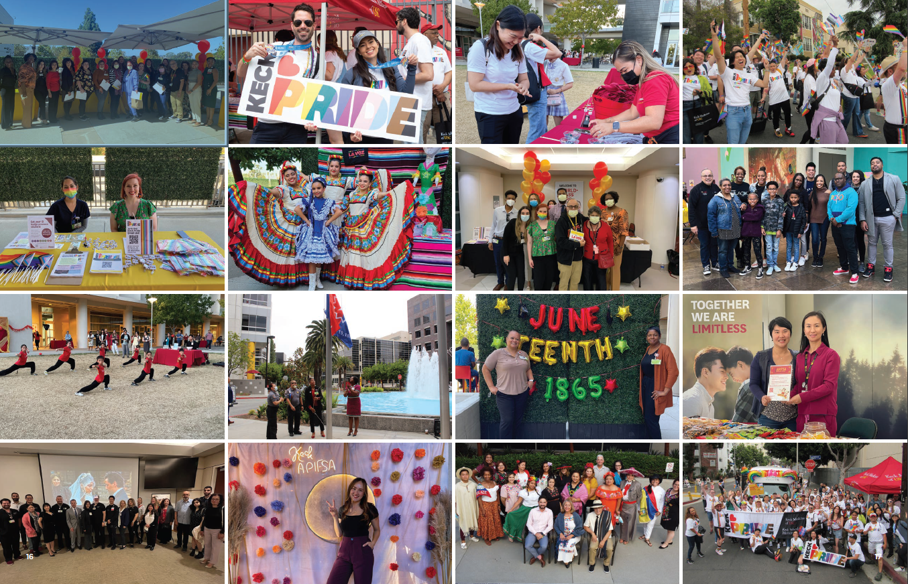
7 Employee Resource Groups thriving and 1 being formed

Slide 22
Miscellaneous, Reproducible Culture Activities
Compassion
Meeting-Free Fridays
Employee Recognition
Performance Management
Mental Health & Wellness Office
Keck Kindness
Smile Cart
©2024 Keck Medicine of USC

Slide 23
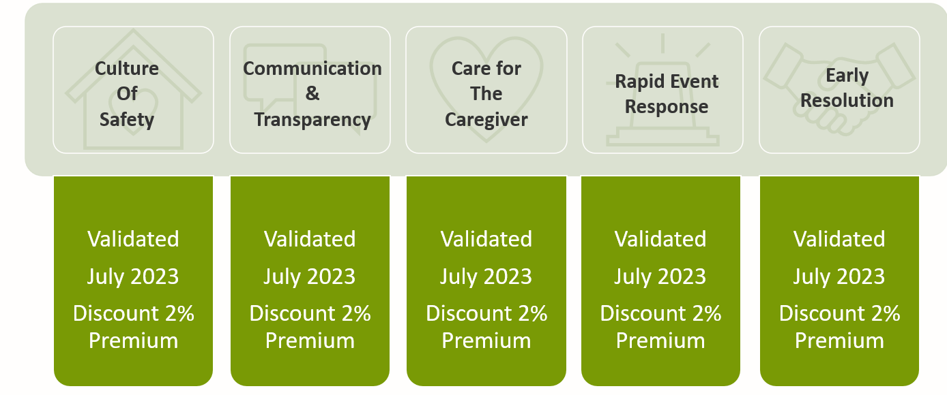
BETA Heart – Received $926,403 in Malpractice Premium Credit for FY24
©2024 Keck Medicine of USC

Slide 24
Building Strength at the Middle: “Leaders Co-Learning with Leaders”

Slide 25
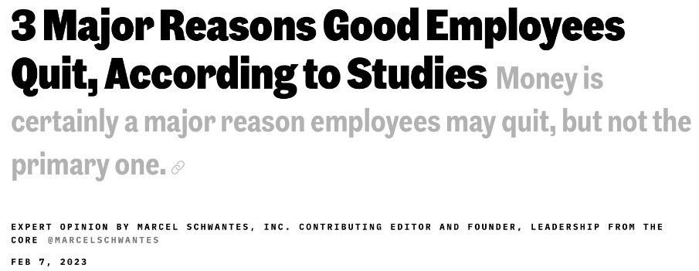
“Gallup has determined from decades of data and interviews with millions of employees that 70 percent of the variance in team engagement is determined solely by the manager. Yet here we are in the post-pandemic age, and organizations that aren't doing massive layoffs continue to think of every strategy for retaining their workers -- from more pay, more perks, more flexible work options, and more mental health resources, to name a few -- without considering the role and impact that the manager makes on the employee.
We've heard this tune before: people leave managers, not companies

Slide 26
Workforce Needs and Expectations Have Shifted
During COVID-19 Years
Employees Expect More Post-Pandemic
Modern Mid-Level Leader (Director Manager)
Keep me safe
Keep me working
Keep me informed
Keep me well
More control over how I work, where I work and what kind of leader I work for
Young people are eager to be part of the world’s healing
Women judge employers by what they do for them in terms of equity and benefits, including digital productivity tools that equip them to manage their work and their families.
Demonstrates empathy, trustworthiness and transparency
Is human-centered, responsible and mindful
Develops best talent and makes world better
Holds self and team accountable
©2024 Keck Medicine of USC

Slide 27
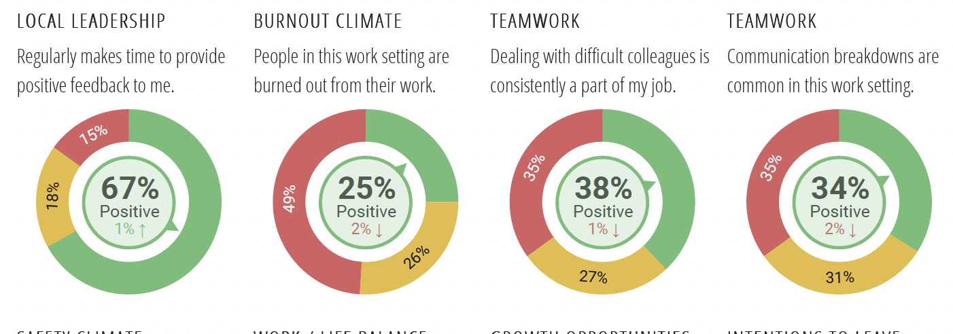
Informing Our Trajectory of Leadership Culture Change
Caregiver Engagement Survey
Leader Survey
Leader Listening Sessions
>2,700 responses
Sustained/improved in 10 of 15 culture and employee engagement domains year over year
Local leadership 59% positive rating
174 unit-based engagement action plans to improve communication and teamwork
121 leader responses
What do you need from your next up leader
Roadblock resolution
Alignment and delegation
Empowerment
Time management
What will it take to achieve your highest hopes for your team:
Management education
Resources
Empowerment
Communication
Time
14 listening sessions with 95 KMC leaders
Collected themes along:
Processes
Communication and responsiveness
Delegation/escalation
HR support
Inter-dependencies
Physician chiefs
©2024 Keck Medicine of USC
Notes:
The following we’d consider our priority, year 1 functions:
Training specialty nurses – to fill the gaps in our periop areas, for example
Launching leadership development – to support our nurse managers and reduce nurse manager turnover
Building a float pool to decrease the expense for travelers. We will set up more time to talk specifically about this in the coming weeks.
Coordinate clinical care collaboratives – to start building relationships and sharing best practices across sites

Slide 28
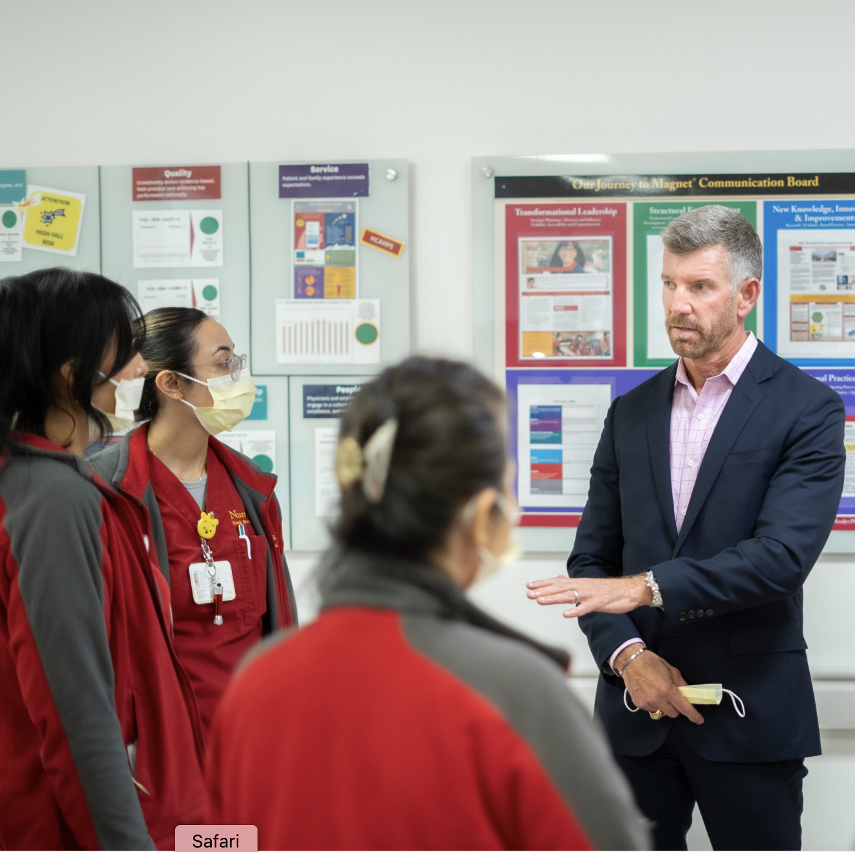
Key Take-Aways
Lots of heart – these leaders are committed and care deeply – and are exhausted
Appreciation for executives who are focusing on the mid-level leader
Gratitude for the opportunity to have listening sessions and discuss their experiences
28
©2024 Keck Medicine of USC

Slide 29
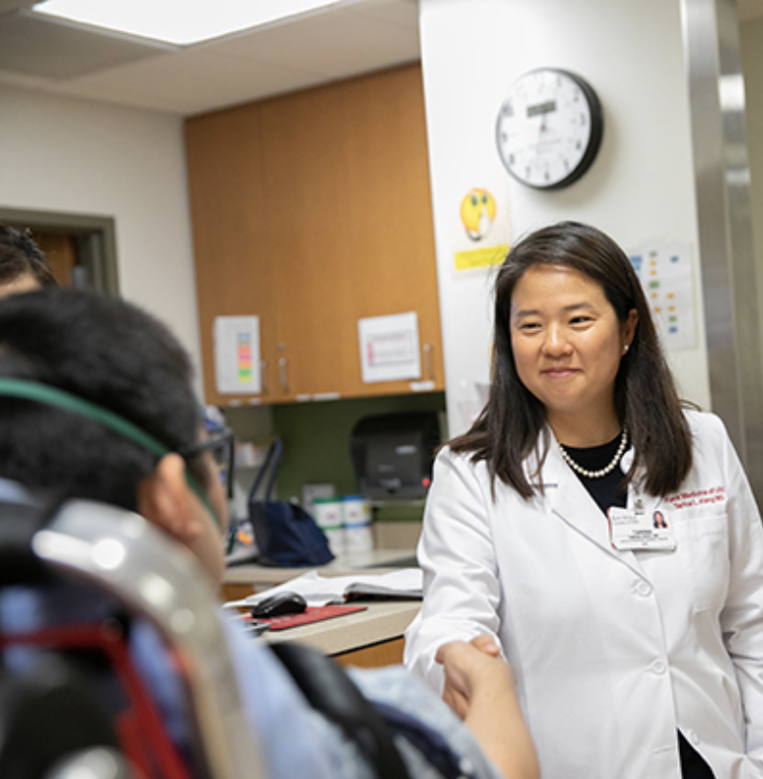
Key Take-Aways
Middle management is more challenging today than it’s ever been – multitude of priorities (some unclear), hundreds of emails and lack of responsiveness
Organization-wide healing needed as a result of the strike and impact to nursing leaders and support functions
Leaders were kind and patient in their comments; they have a lot of hope and want to do their best
29
©2024 Keck Medicine of USC

Slide 30
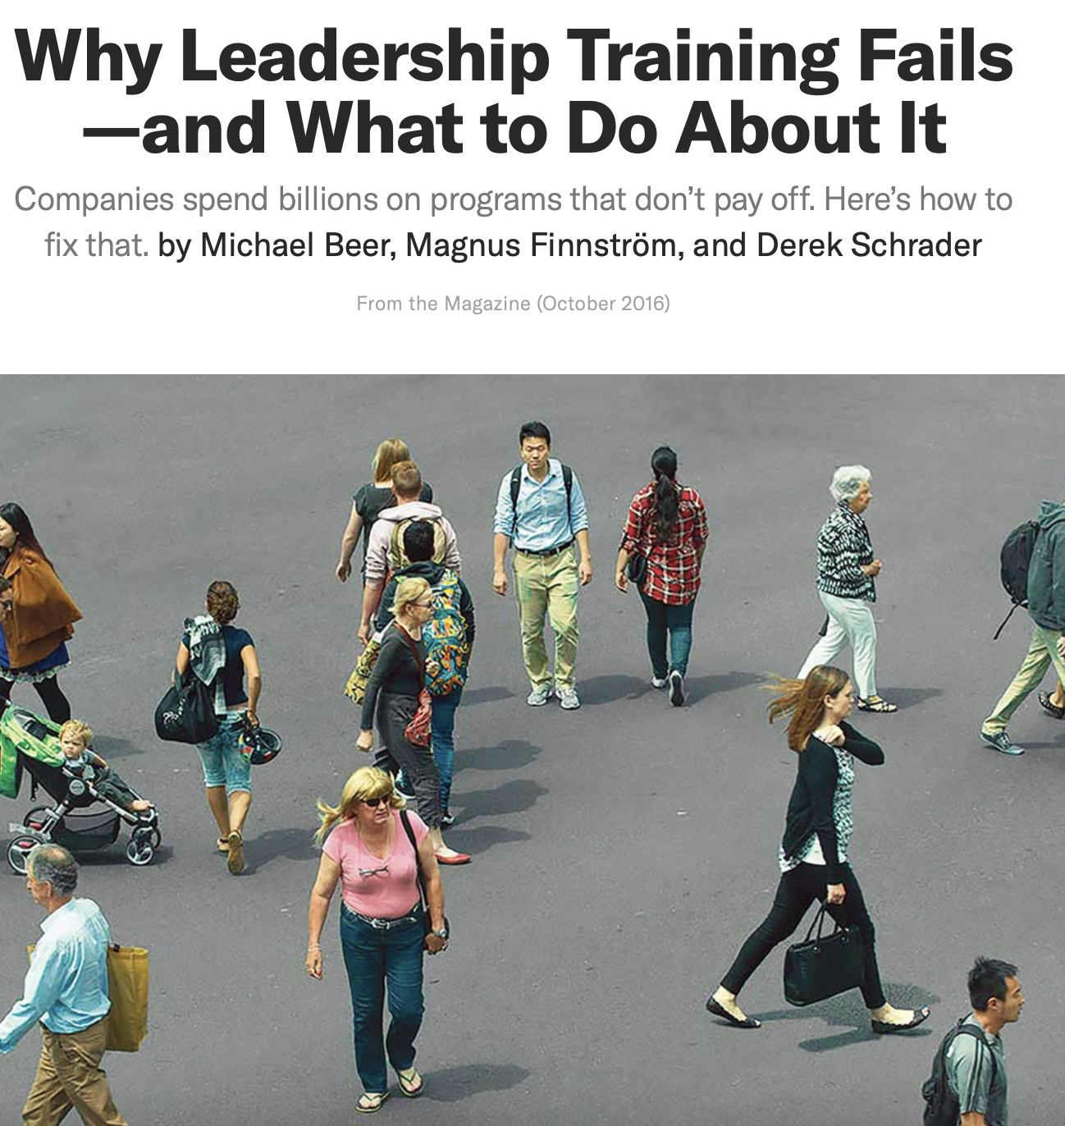
Organizations are systems of interacting elements: Roles, responsibilities, and relationships are defined by organizational structure, processes, leadership styles, people’s professional and cultural backgrounds, and policies and practices.
An uncomfortable truth: A failure to execute on strategy and change organizational behavior is rooted not in individuals’ deficiencies but, rather, in the policies and practices created by top management.
“If the system does not change, it will not support and sustain individual behavior change.”

Slide 31
Our Transformational Leadership Model

Slide 32
Transforming Our Purposeful Leadership Environment
Daring Leadership Framework
“Book Club” and DTL curricula driver
Drive for Results and Sustainment
Based on listening to our leaders
Structures and frameworks to enable hardwiring
Leadership standard work and leadership framework
Dare to lead as basis and “common language”
Daring teams rollout to construct our multi-directional leadership channels
50 C-suite and top leaders trained in DTL
Forum for 360º internal leader co-learning for over 250 front line leaders
Workbook-based curriculum (7 sessions) from Dare to Lead by Brene Brown.
Leadership groups learning centers around operating units
Leaders having leadership conversations with leaders
Common leadership thread to be established front line and upward
Establish understanding of needs of operating units – how do concepts apply in ‘my world’
Focuses on the “you” in the leadership equation
Skill building: ET, monthly leadership team, individual team based, monthly lunch and learn
New leader training (annually)
Survey and engagement tools increased
CEO listening sessions
Leadership portfolio and intro developed
Book club transitioned to bimonthly Leadership Co-Learning with ET sponsored curriculum aligning DTL with organizational priorities
©2024 Keck Medicine of USC
Notes:
The following we’d consider our priority, year 1 functions:
Training specialty nurses – to fill the gaps in our periop areas, for example
Launching leadership development – to support our nurse managers and reduce nurse manager turnover
Building a float pool to decrease the expense for travelers. We will set up more time to talk specifically about this in the coming weeks.
Coordinate clinical care collaboratives – to start building relationships and sharing best practices across sites

Slide 33
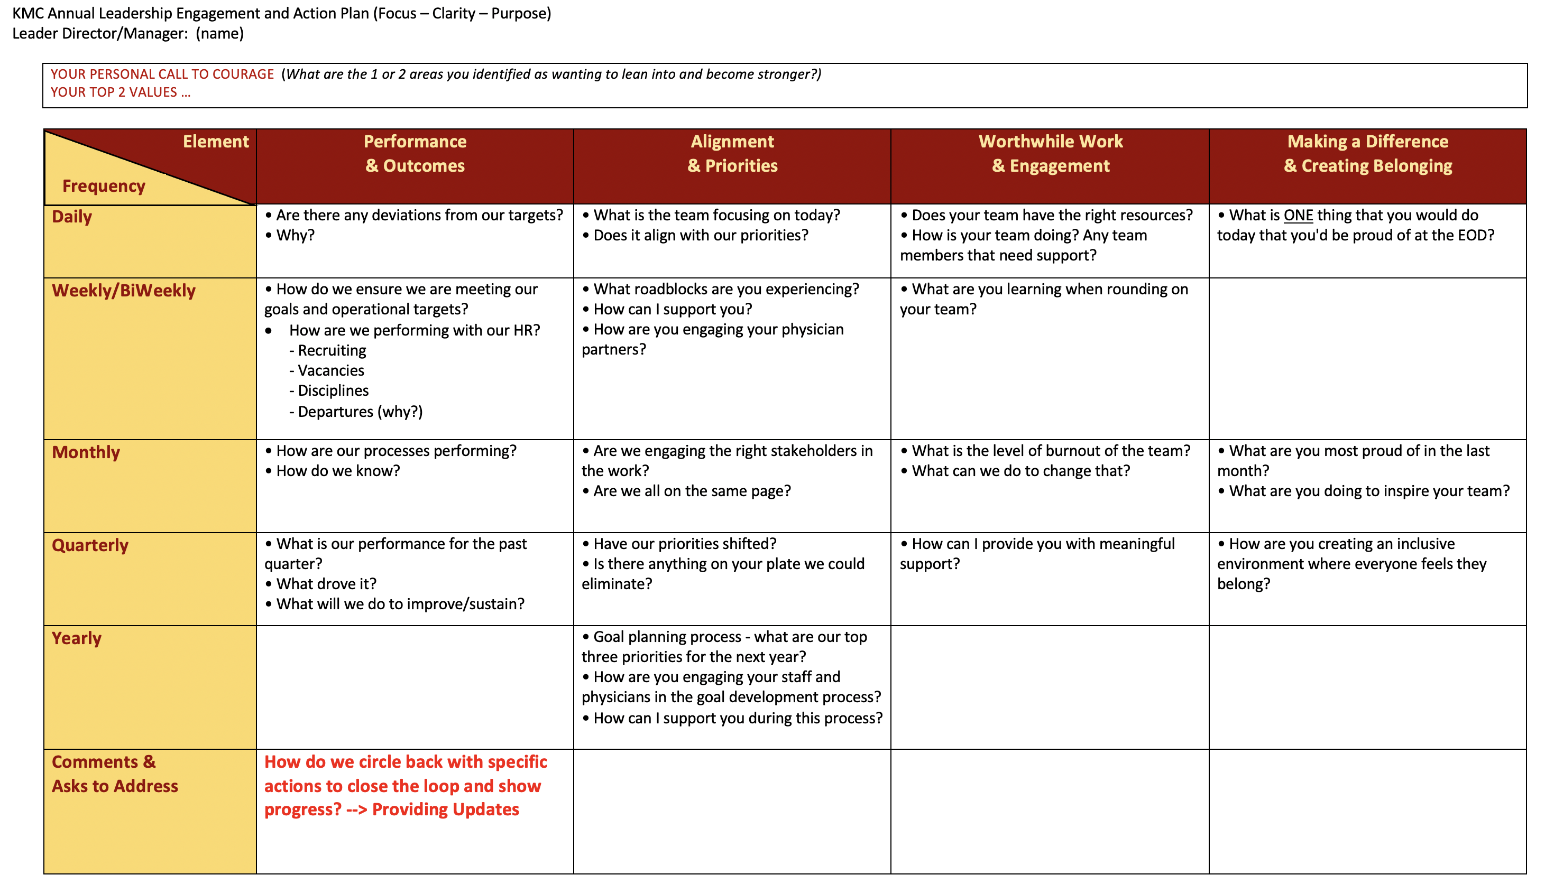
Leadership Standard Work Framework
Each unit leader to have tailored engagement action plan with two-way intentionality to ensure focus, clarity and purpose
Are we continuing this work in having two-way communication? Hearing others is more valuable than the solution itself – our data suggests opportunities exist
©2024 Keck Medicine of USC

Slide 34
Demonstrating Value

Slide 35
Leader Feedback: How’s It Going?
The time and investment you are making is significant. I am very appreciative of your recognition and commitment to us as a leadership team.
I love the common language we are building across our teams.
It was helpful having my leader co-learn these concepts with me and talking about how to influence in our environment.
I see a positive change. We are ready to rumble….in a good way.
It’s a bit easier to rumble with curiosity and trust, I feel more supported when talking and making difficult decisions.
I learned that everyone is going through similar situations. Also, I have found that I can use these tools in my personal life with family and friends.
I appreciate the effort, mindfulness, and care that is being poured into developing us as leaders. I love the collaborative/team approach. It makes positive change feel real and within reach.
©2024 Keck Medicine of USC

Slide 36
Demonstrating Organizational Excellence
Quality Outcomes & Experience
Efficiency: Creating Capacity
Keck CMS 5-Star rating, 2023
Reduced contract labor equating to reduction of over $13m/46% year over year
Vizient Quality and Safety rankings: Top 20 in 2023; well-positioned for Top 10 in 2024
Key length of stay measures reflect better than Vizient risk-adjusted; expected placing top 11 AMCs for Keck Hospital FY24; saving unnecessary hospital days
Successful surveys for TJC VAD and ACS Commission on Cancer
Patient experience measured by likelihood to recommend >96% two years running at Keck Hospital
Overall financial health positive with Medical Center EBIDA improved 43% from prior year and is performing 14% better than budget
Nursing Magnet redesignation, one of 54 in CA
©2024 Keck Medicine of USC

Slide 37
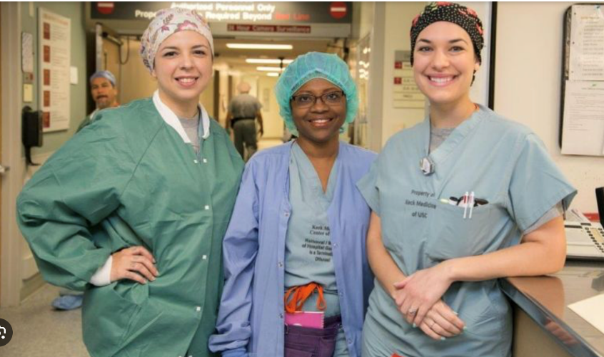
Keck Medicine Numbers Demonstrate Progress
HR Trend Data | Jul 2022 | Feb 2024
1st Year of Service Nursing Turnover | 27.0% | 11.5%
Nursing Turnover | 11.3% | 6.09%
1st Year of Service Manager and Above Turnover | 9.13% | 0.0%
Manager and Above Turnover | 14.1% | 7.25%
1st Year of Service Turnover | 27.1% | 23.4%
Total Turnover | 12.4% | 9.02%
According to the 2023 NSI National Healthcare Retention & RN Staffing Report, the national hospital turnover rate stands at 22.7%, a 3.2% decrease from 2021
Source: Keck Medicine of USC, 2024

Slide 38
Lessons Learned

Slide 39
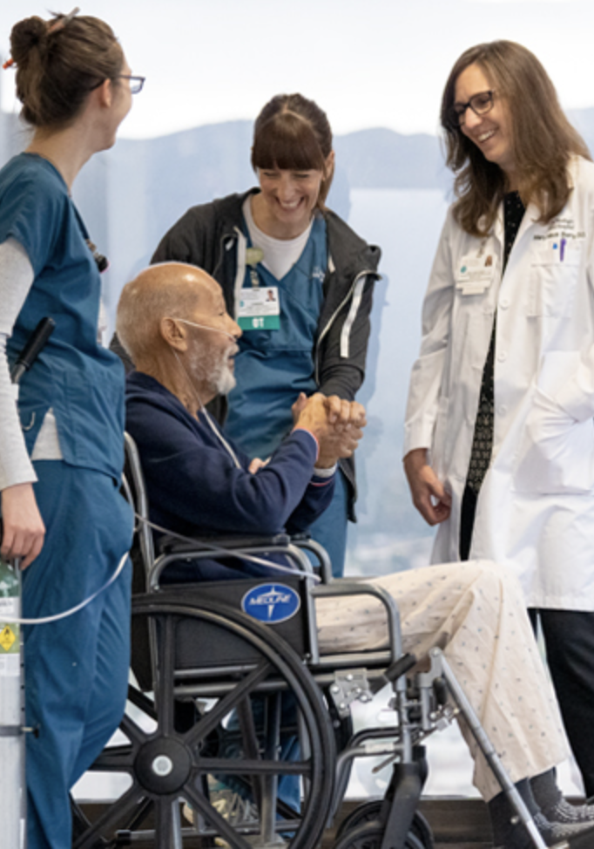
Lessons Learned
Leadership commitment, organizational values, agreed-upon metrics and a reporting system are foundational to success.
Well-being programs don’t replace the need for robust professional development programs and opportunities.
©2024 Keck Medicine of USC

Slide 40
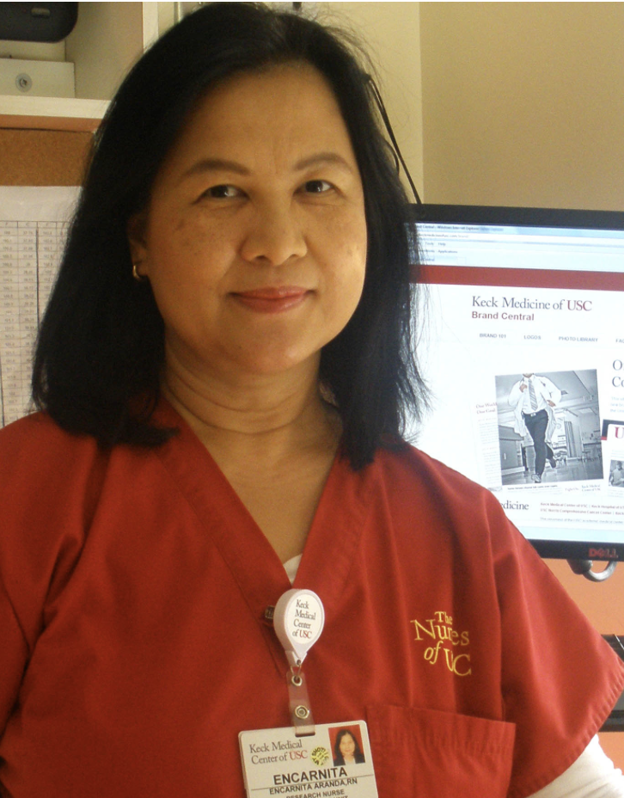
Lessons Learned
Transparency, humility and genuine expressions of concern for individuals must be embedded in every activity and interaction.
The best programs that focus on professionalism, resiliency and well-being aren’t discrete or one-off activities – they become part of your organizational ethos.
©2024 Keck Medicine of USC

Slide 41
Rod Hanners
Rod Hanners is CEO of Keck Medicine of USC and President and CEO of USC Health System. He is responsible for oversight of the university’s clinical activities, including USC Care Medical Group, Keck Medical Center of USC, USC Verdugo Hills Hospital and more than 67 outpatient clinics.
Previously, Rod was COO for Keck Medicine of USC, as well as CEO for Keck Medical Center. During his tenure, Keck Medicine experienced tremendous success including ranking No. 18 on U.S. News & World Report’s 2020–21 Best Hospitals Honor Roll.
Prior to joining Keck Medicine, Rod served as senior vice president and COO for Children’s Hospital Los Angeles and held various positions in the Kaiser Permanente system, Preceding his career in health care, he was a naval officer in the U.S. Submarine force. He holds a bachelor’s degree in electrical engineering from California State University, Long Beach, and a master’s equivalent degree in nuclear engineering from the U.S. Navy’s Nuclear Power School in Orlando, Florida. Rod.Hanners@med.usc.edu

Slide 42
Marty Sargeant
Marty Sargeant is CEO of Keck Medical Center of USC, comprised of Keck Hospital of USC and USC Norris Cancer Hospital. He provides executive leadership while maintaining strong relationships with department chairs, faculty, staff and leadership. He is committed to personally engaging with frontline caregivers and maintains a constant presence at the medical center, creating opportunities to enhance patient care and ensure that physicians and staff have the support they need to excel in their roles.
Prior to his role as CEO, Marty served as chief operating officer for Keck Medical Center. Before joining Keck Medicine, he was chief operating officer for City of Hope and held a number of positions over a 17-year tenure with the Cleveland Clinic.
Previous to his career in healthcare, Marty served as an F-15 combat pilot in the United States Air Force, for which he received two medals of commendation and served as a flight instructor. He is a graduate of Virginia Military Institute and holds a Master in Business Administration from Case Western Reserve University. Marty.Sargeant@med.usc.edu

