Slide 1
Making Time to Lead:
Nine innovative ideas to engage employees right now
Linda Matzigkeit, Chief Administrative Officer

Slide 2
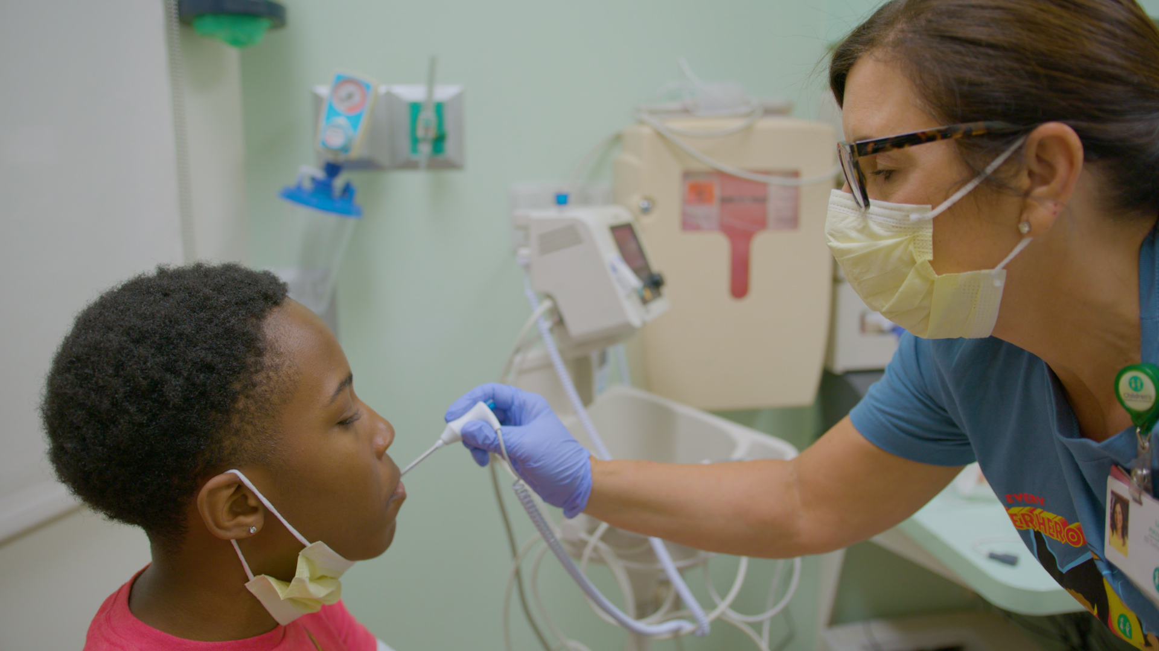
Make time to get up close and personal

Slide 4
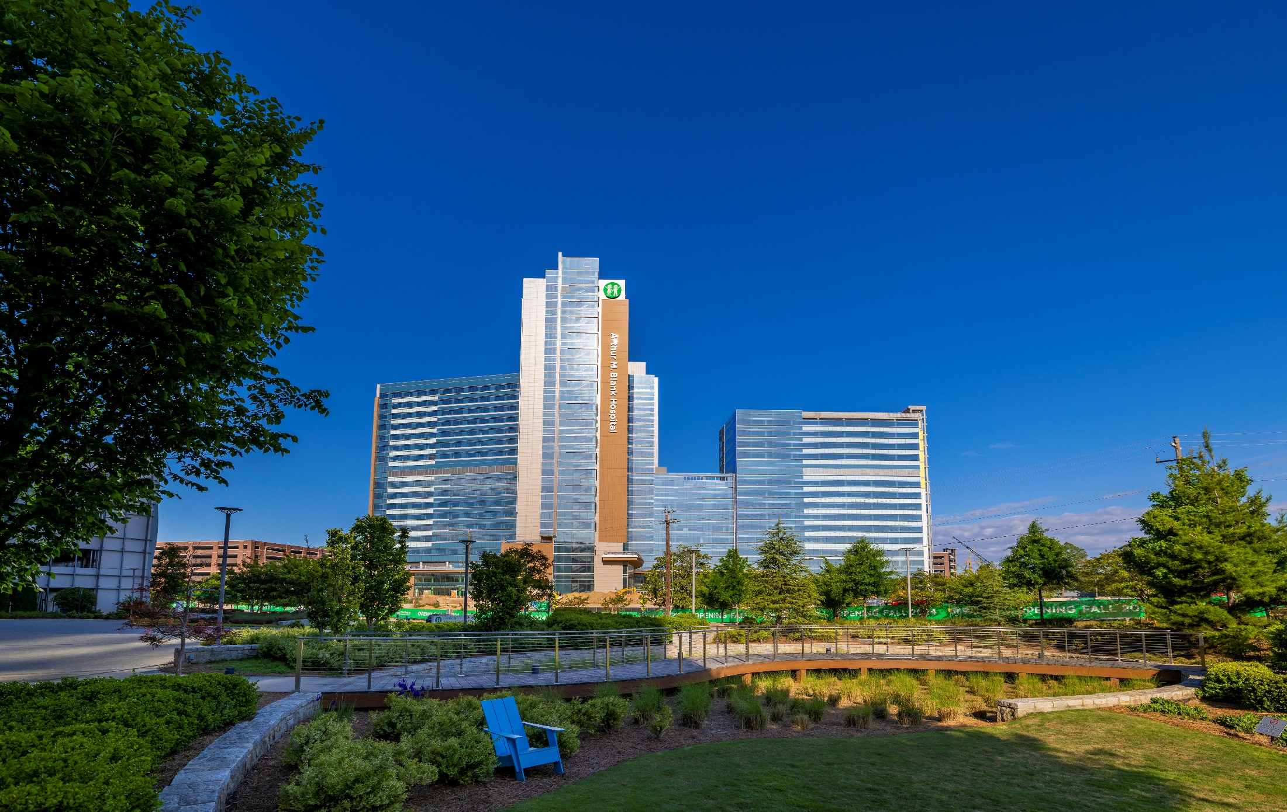
Arthur M. Blank Hospital
September 29, 2024
1,000 new employees

Slide 5
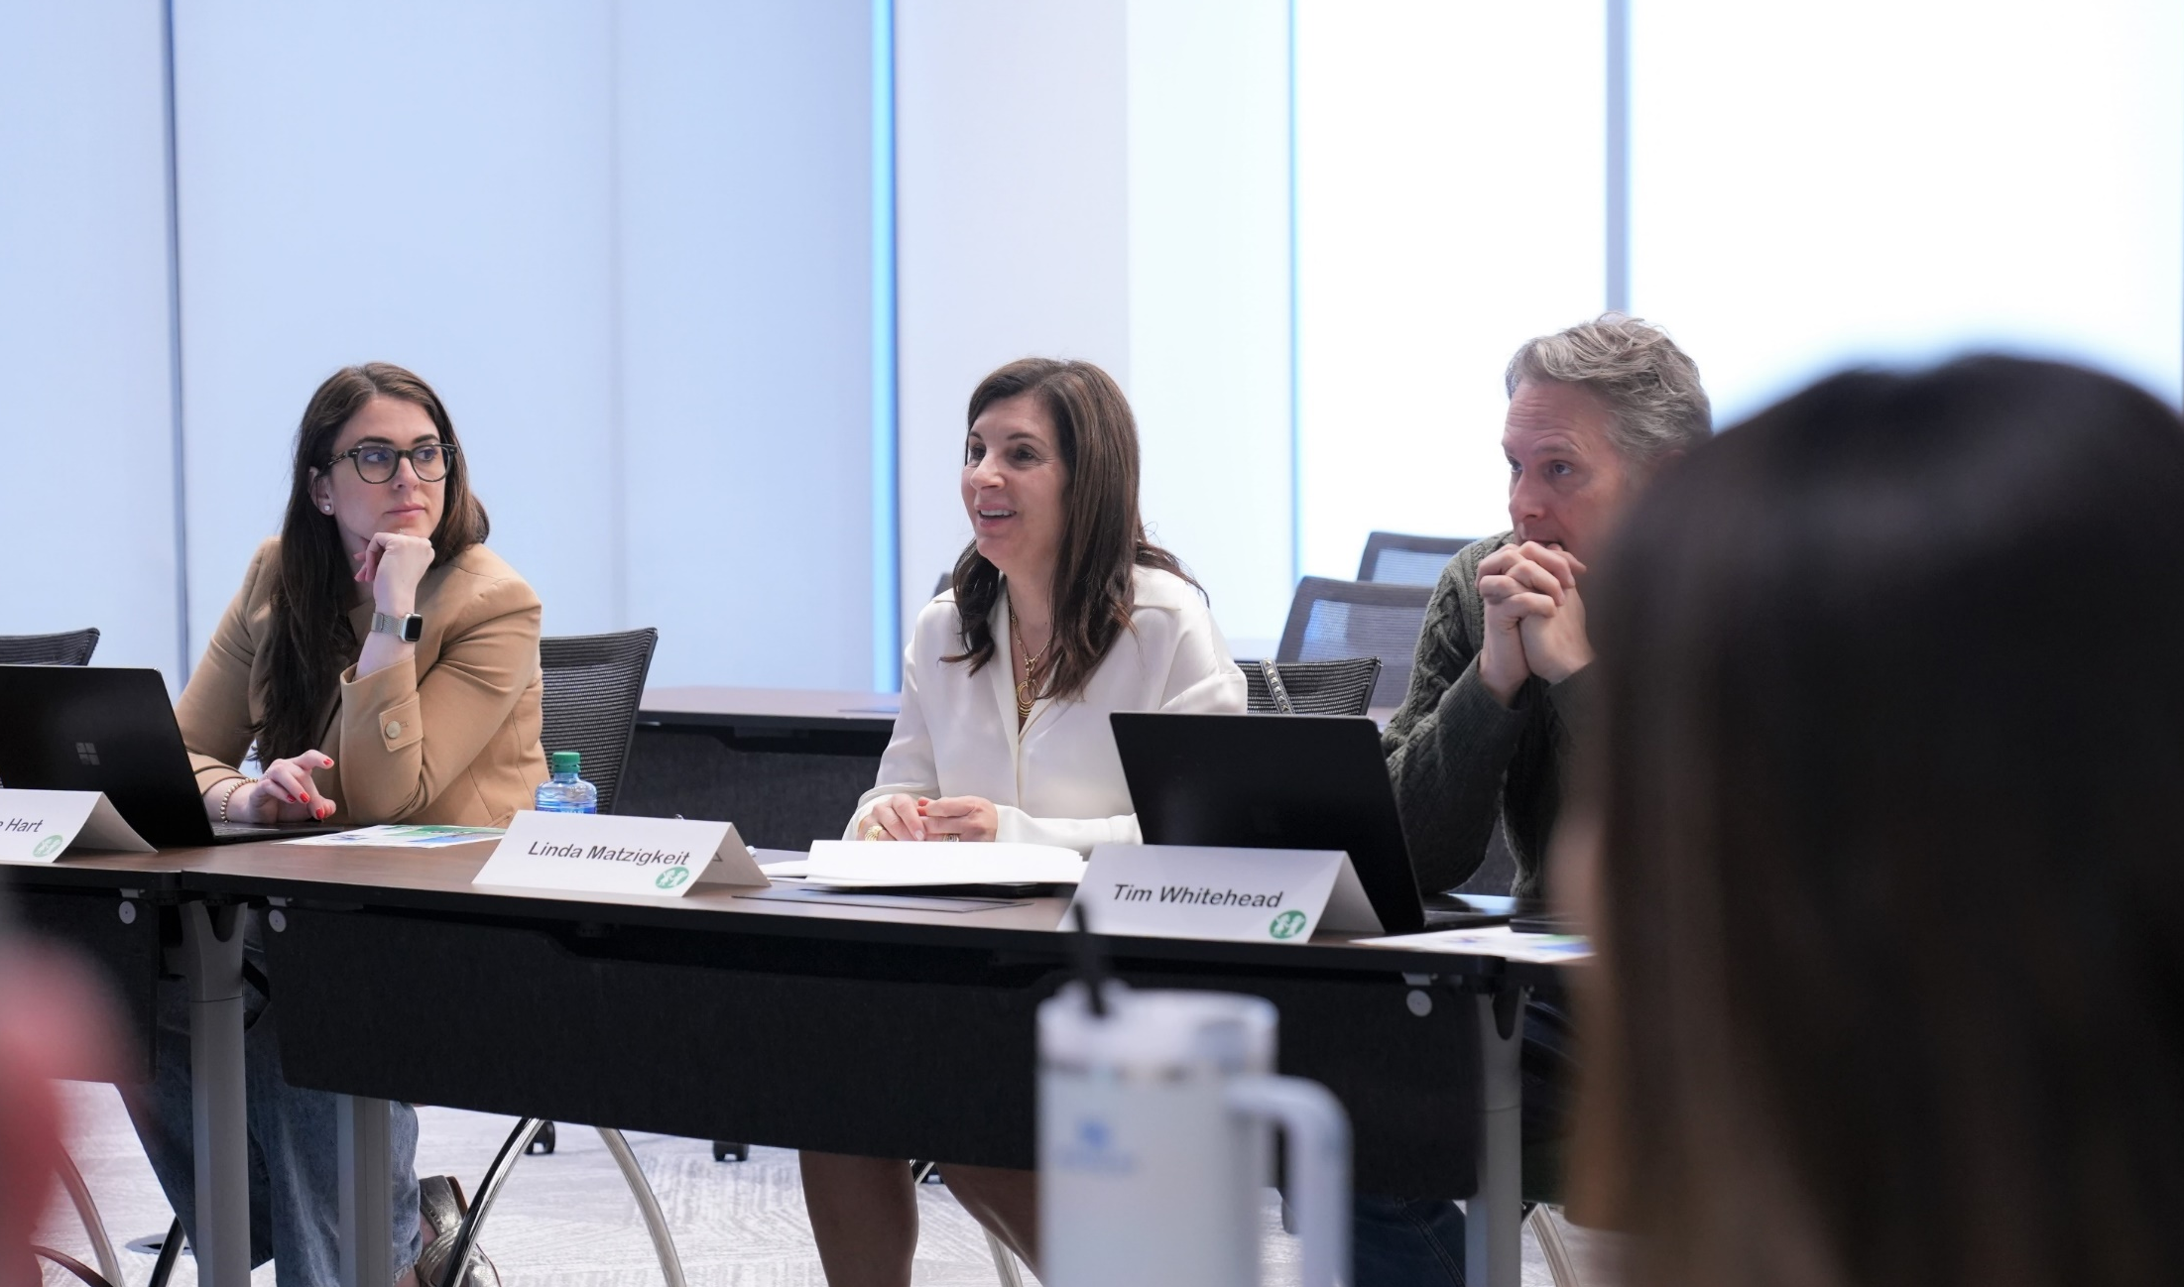
Culture Champions

Slide 6
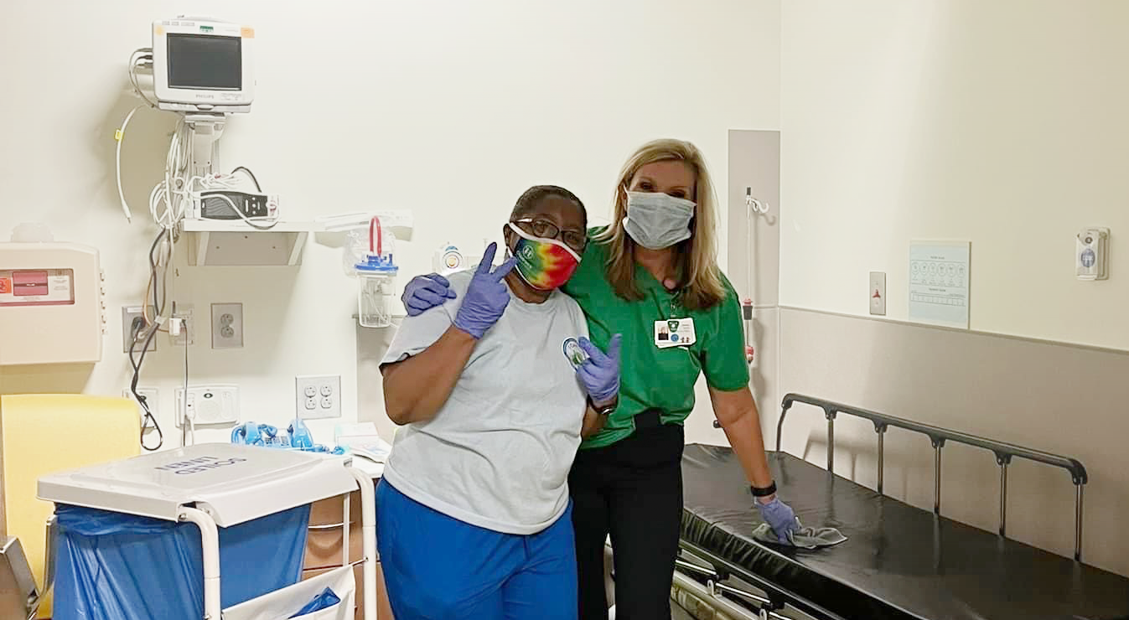
Leader Lean In

Slide 7
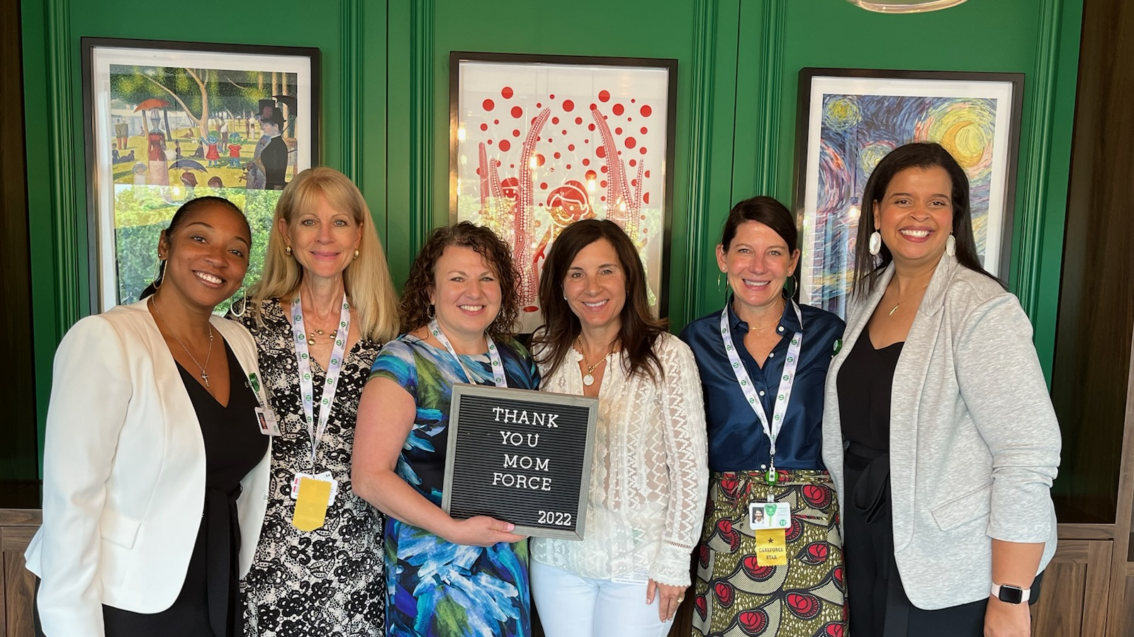
MomForce

Slide 8
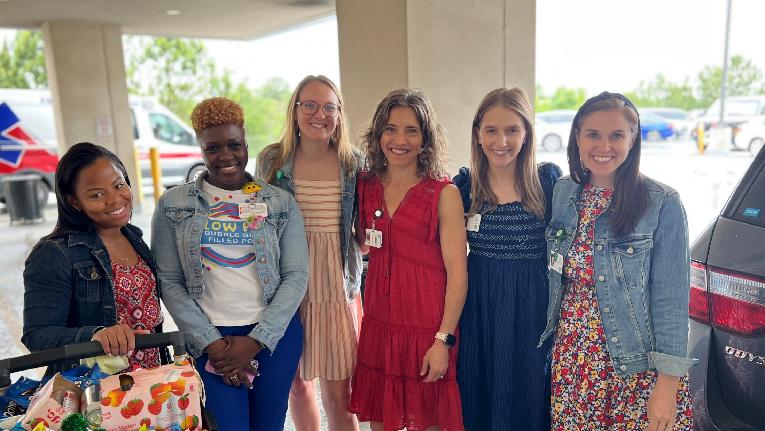
Adopt A Team

Slide 9
Lunch with Linda

Slide 10
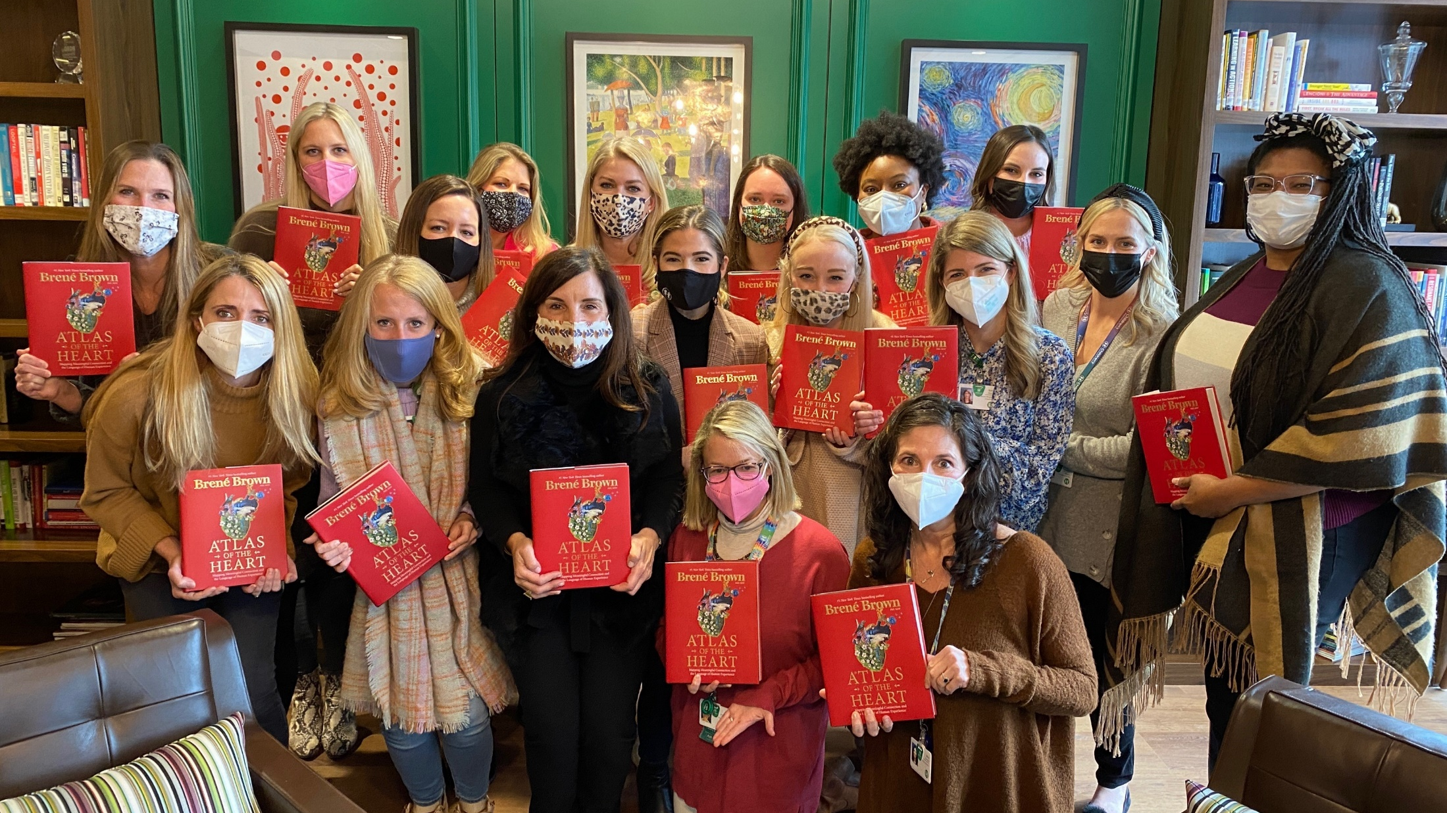
Book Club

Slide 11
Handwritten Cards

Slide 12
Run with Linda

Slide 13
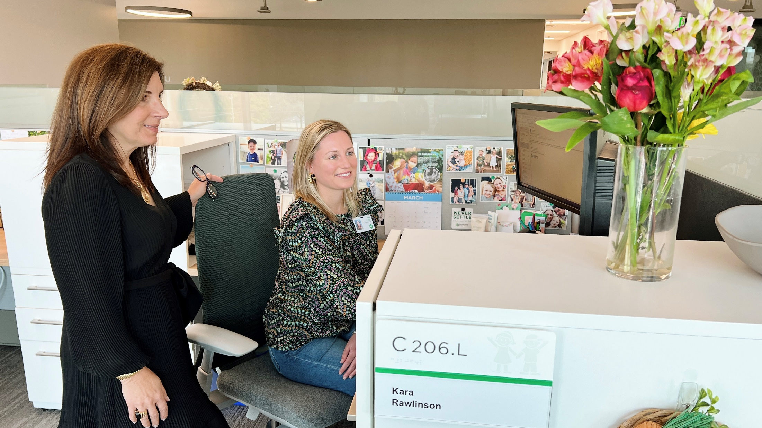
Day in the Life

Slide 14
Results
System retention 90%
Nursing retention 91%
Engagement 83%
Vacancy rate < 5%
1,000 new grad nursing hires over the past two years
Use of traveling nurses down 95% (down from 239 to 13)

Slide 15
Remember, make time to …
Create opportunities that drive personal, meaningful conversations
Strengthen connections between clinical and non-clinical teams​​
Champion initiatives that connect leaders to insight from the front line
Never underestimate the impact of a handwritten note

Slide 16
Thank you

